Slide 1
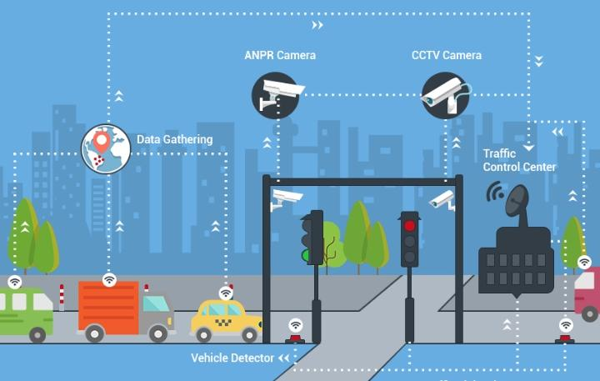
B.Atchayalakshmi
6E10A345F7BB1649182459BD9D88EBSS

Slide 2

Project Name : Traffic Management

Slide 3
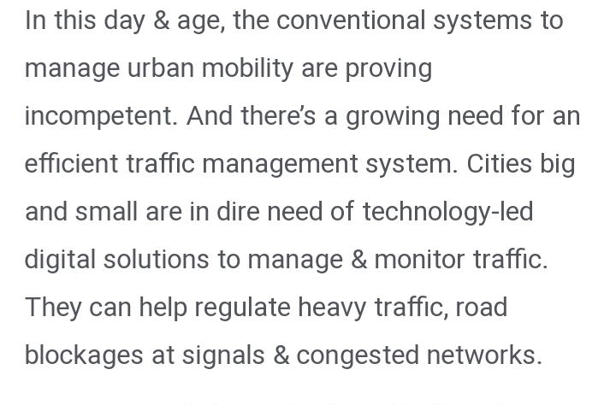
Objective
20XX | 20XX | 20XX | 20XX

Slide 4

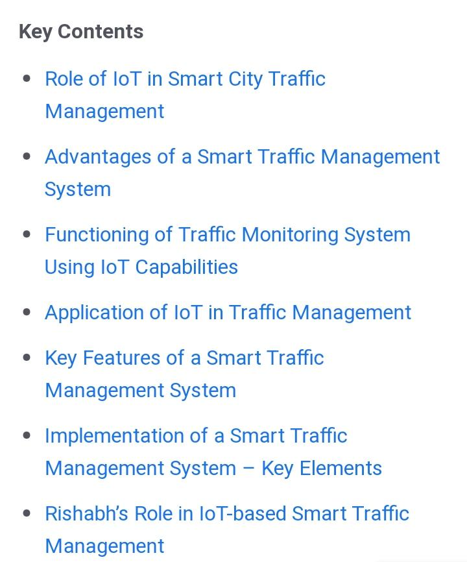
Key contents

Slide 5
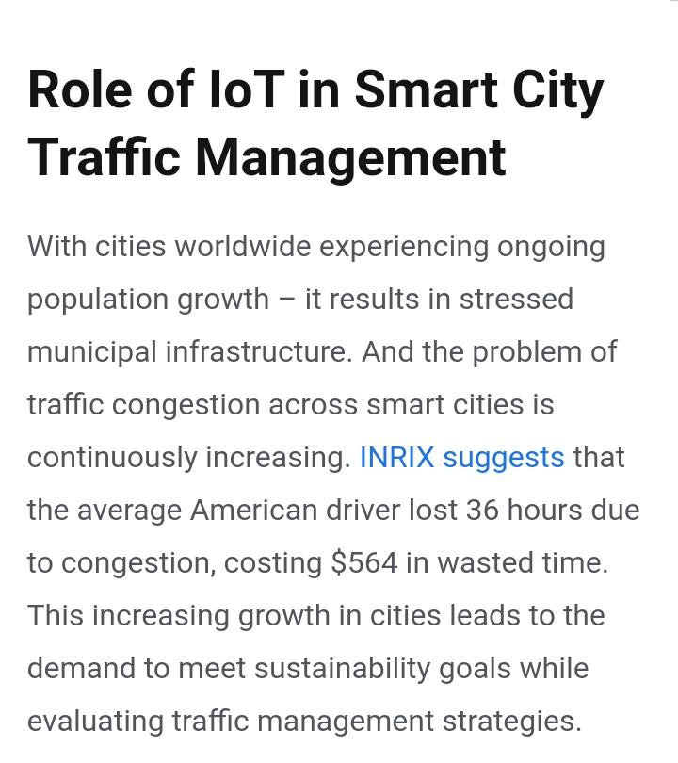
Role :
Show the audience you anticipated their questions.
Leave room for Q&A, but use the Appendix as a way to show that you both thought about those questions and have solid answers with supporting information. Let the audience test their understanding of the problem and the solution you’ve outlined - questions give them a chance to talk themselves into your approach, and give you a chance to show mastery of the subject.

Slide 6
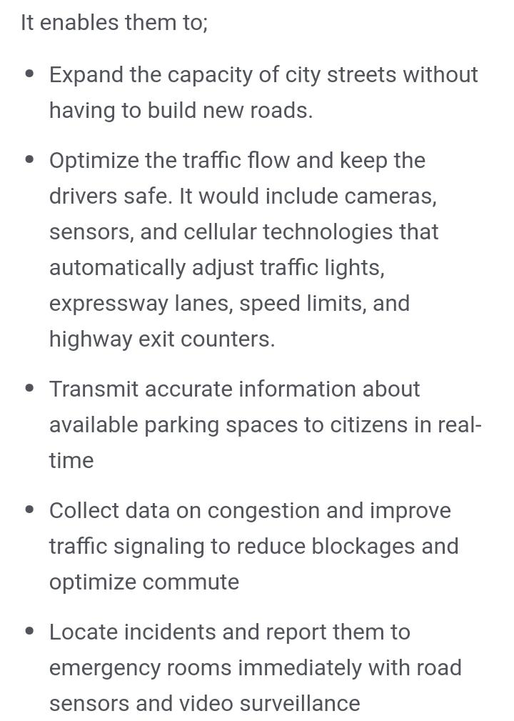
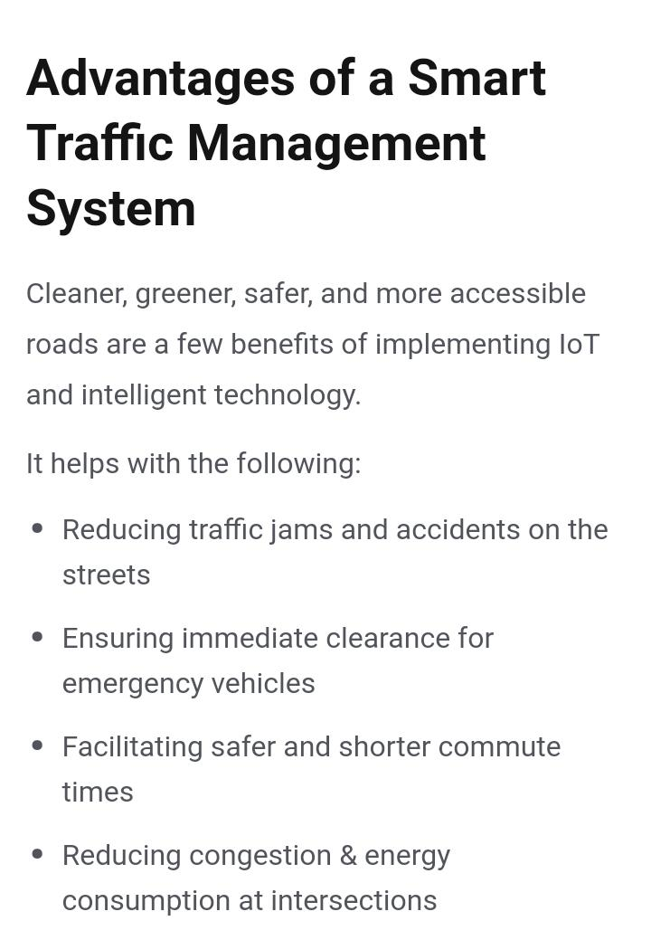

Slide 7
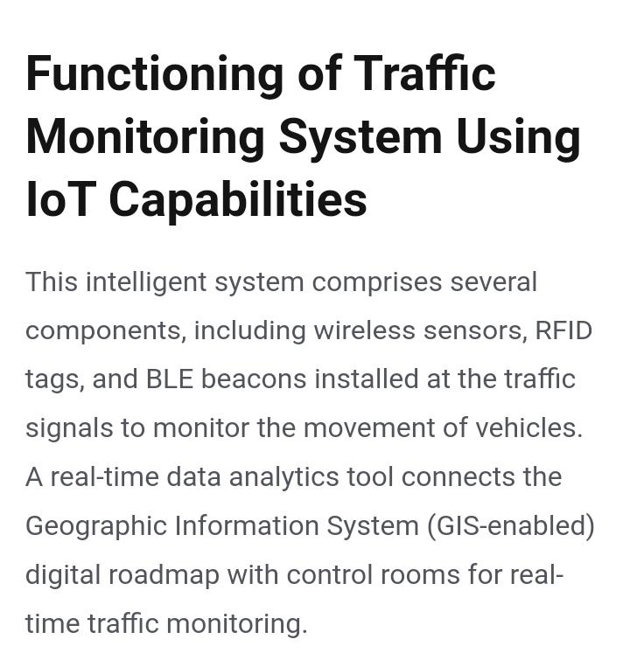
Consumer
Venue
Artist

Slide 8

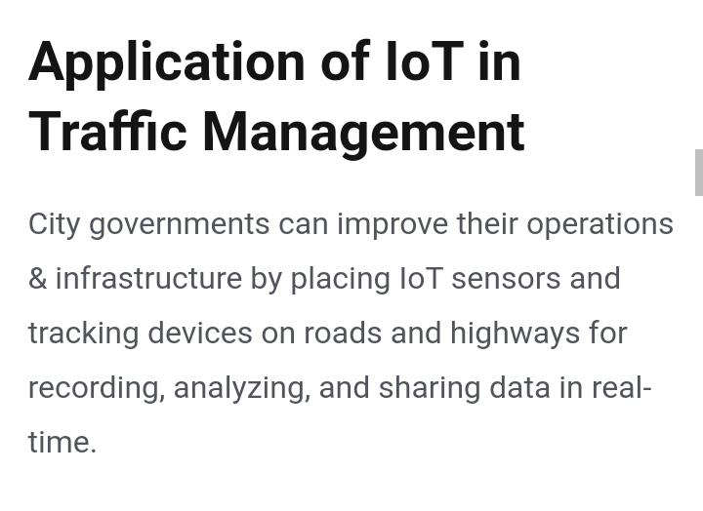
The technology:
GPS + RFID

Slide 9

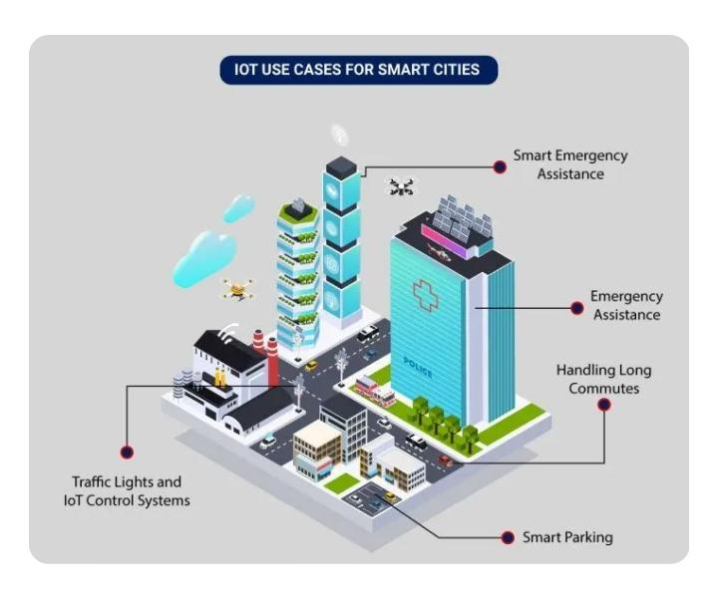

Slide 10
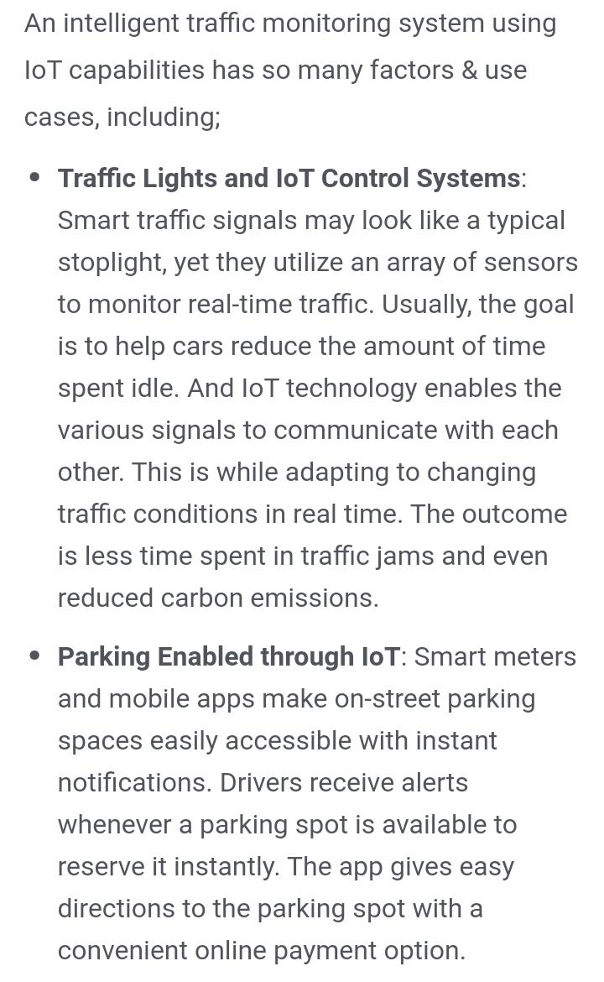
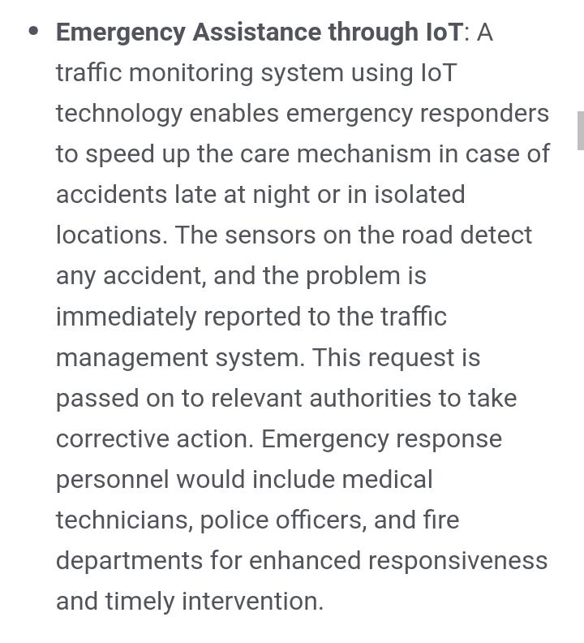

Slide 11
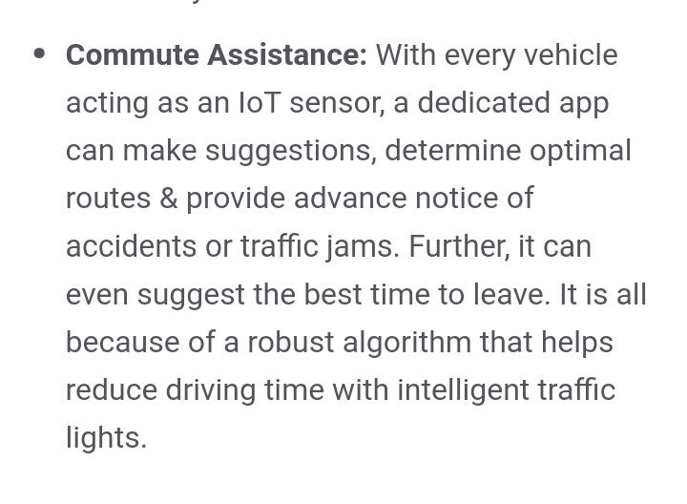

Slide 12
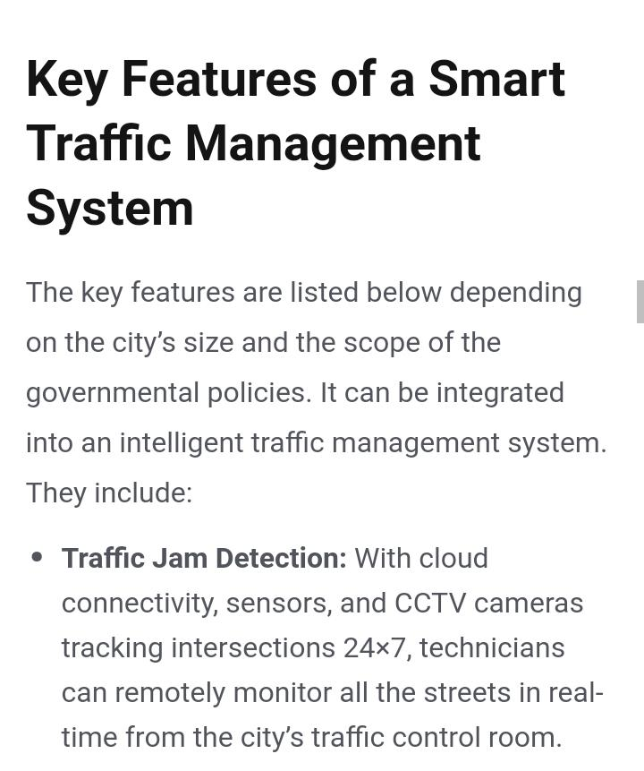

Slide 13
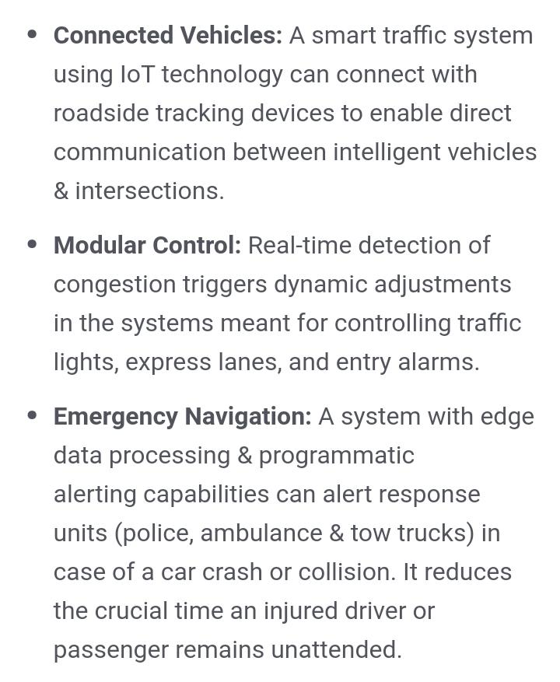
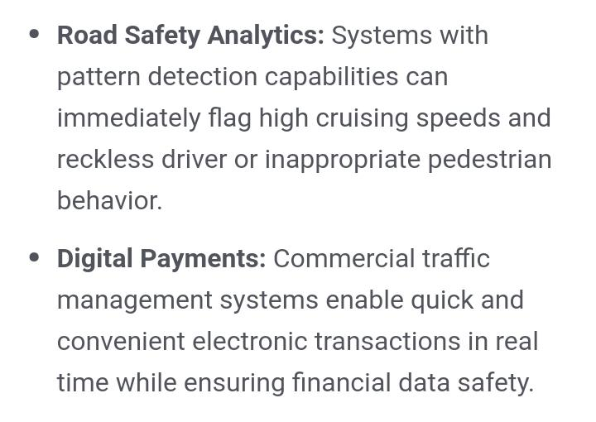

Slide 14
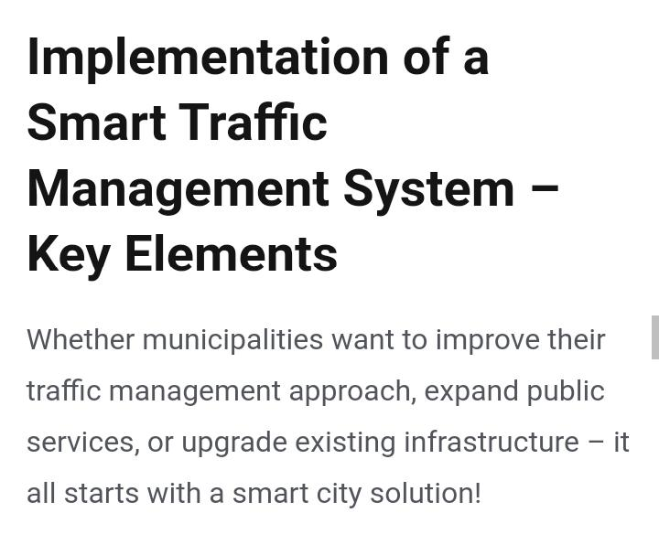

Slide 15
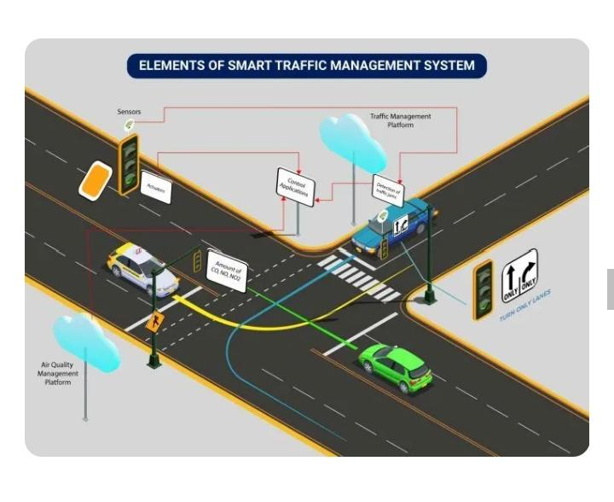

Slide 16
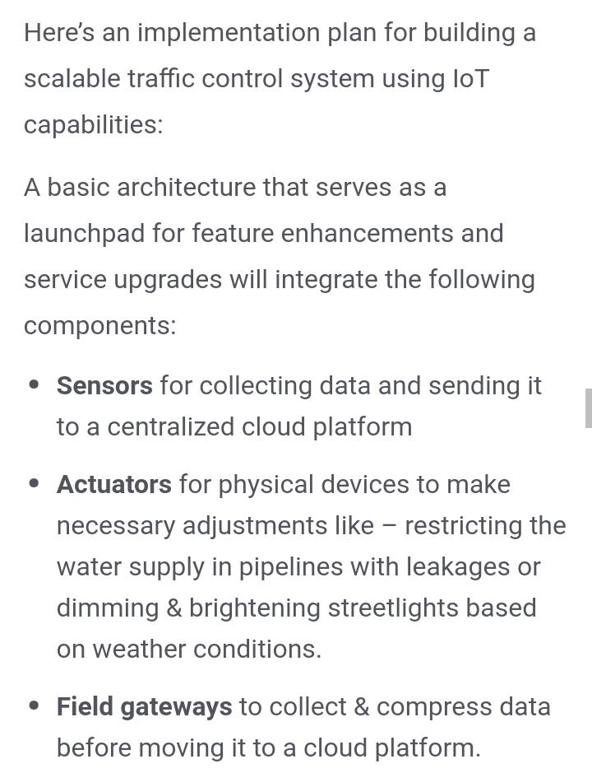
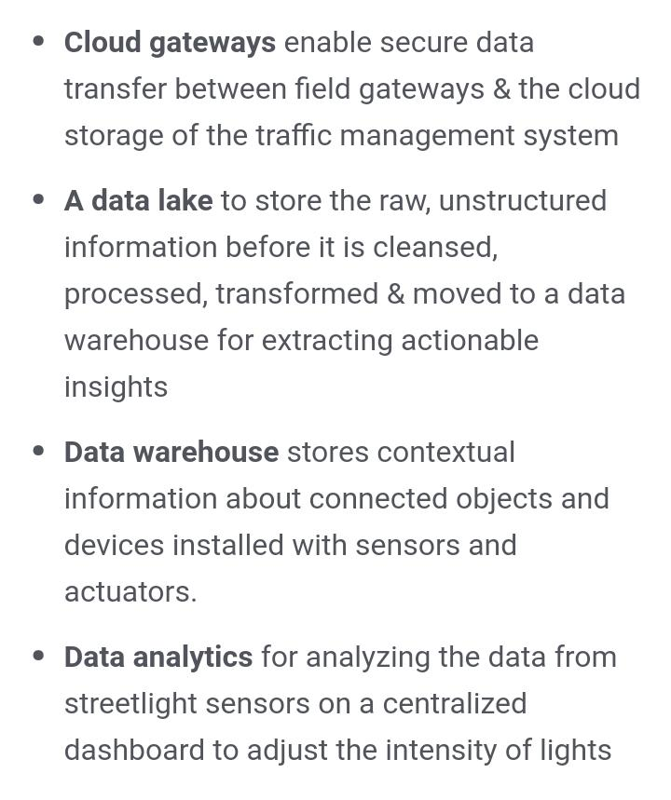

Slide 17
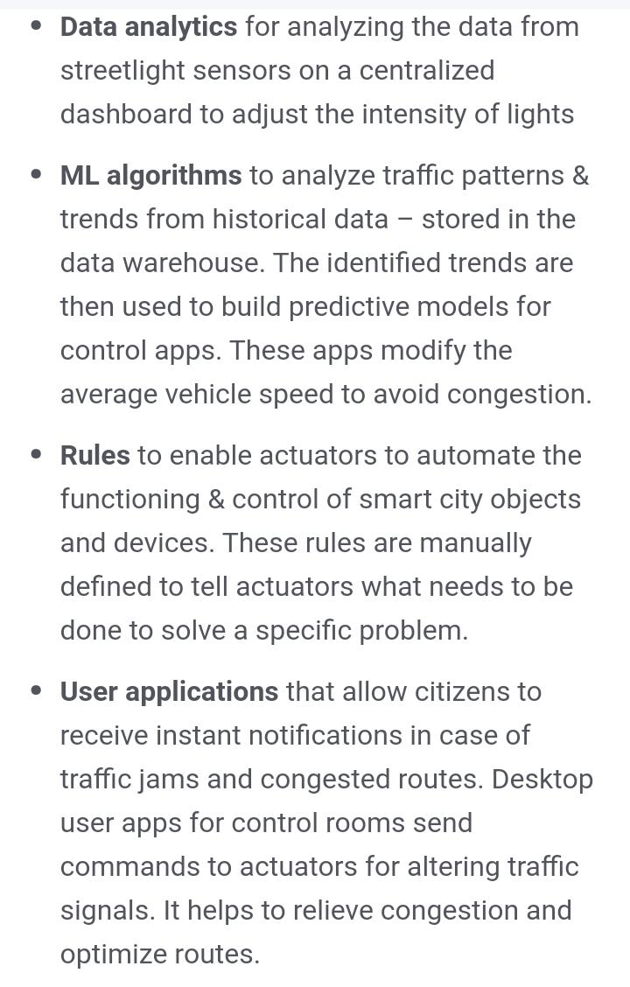

Slide 18
Thank you

